Slide 1


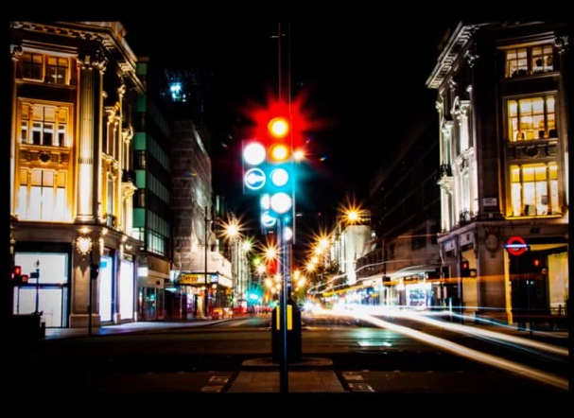
 | Nitte Meenakshi Institute of Technology (AN AUTONOMOUS INSTITUTION AFFILIATED TO VISVESVARAYA TECHNOLOGICAL UNIVERSITY, BELGAUM) PB No. 6429, Yelahanka, Bangalore 560-064, Karnataka Telephone: 080- 22167800, 22167860, Fax: 080 - 22167805
Department of Computer Science and Engineering
AN INNOVATIVE ROAD AND TRAFFIC SAFETY MANAGEMENT SYSTEM USING IoT
Project Group No. 21CSP51
Presentation By:
AMAN RAJ 1NT20CS017
HARSH SUHANE 1NT20CS071
MOHIT RANJAN 1NT20CS105
SAMARTH CHAUHAN 1NT20CS152
Guided By:
Name of the Guide: Dr. Dileep Reddy Bolla
Designation: Associate Professor.

Slide 2
 | Nitte Meenakshi Institute of Technology (AN AUTONOMOUS INSTITUTION AFFILIATED TO VISVESVARAYA TECHNOLOGICAL UNIVERSITY, BELGAUM) PB No. 6429, Yelahanka, Bangalore 560-064, Karnataka Telephone: 080- 22167800, 22167860, Fax: 080 - 22167805
Department of Computer Science and Engineering
TABLE OF CONTENTS
Background
Application of IoT
Research motivation and Problem statement
Research objectives
Literature Survey
Results
Conclusions
References
AY 2023-2024
2

Slide 3
BACKGROUND

Slide 4

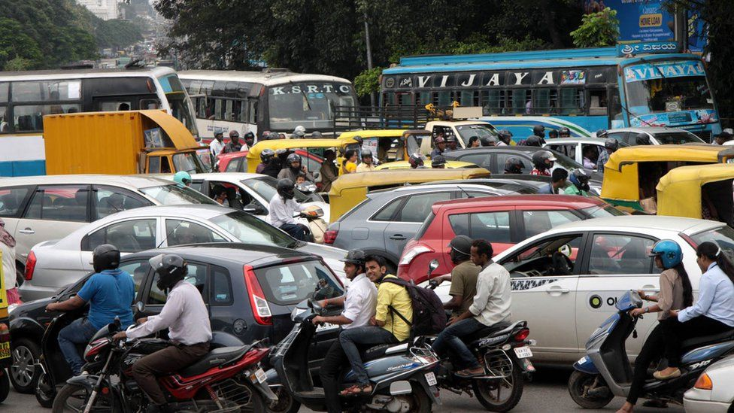
With the exponential growth of urbanization in India, there is also an increase in traffic congestion in day-to-day life, and the traditional traffic management system is ineffective.
This makes road safety one of the prime importance because of the rise in deaths due to crashes or accidents on the road .
And with the increasing rate of population, the number of vehicles on the roads are increasing simultaneously. This results in increase of rate of traffic jams on daily basis.

Slide 5
APPLICATION OF IoT
AY 2023-2024
5

Slide 6
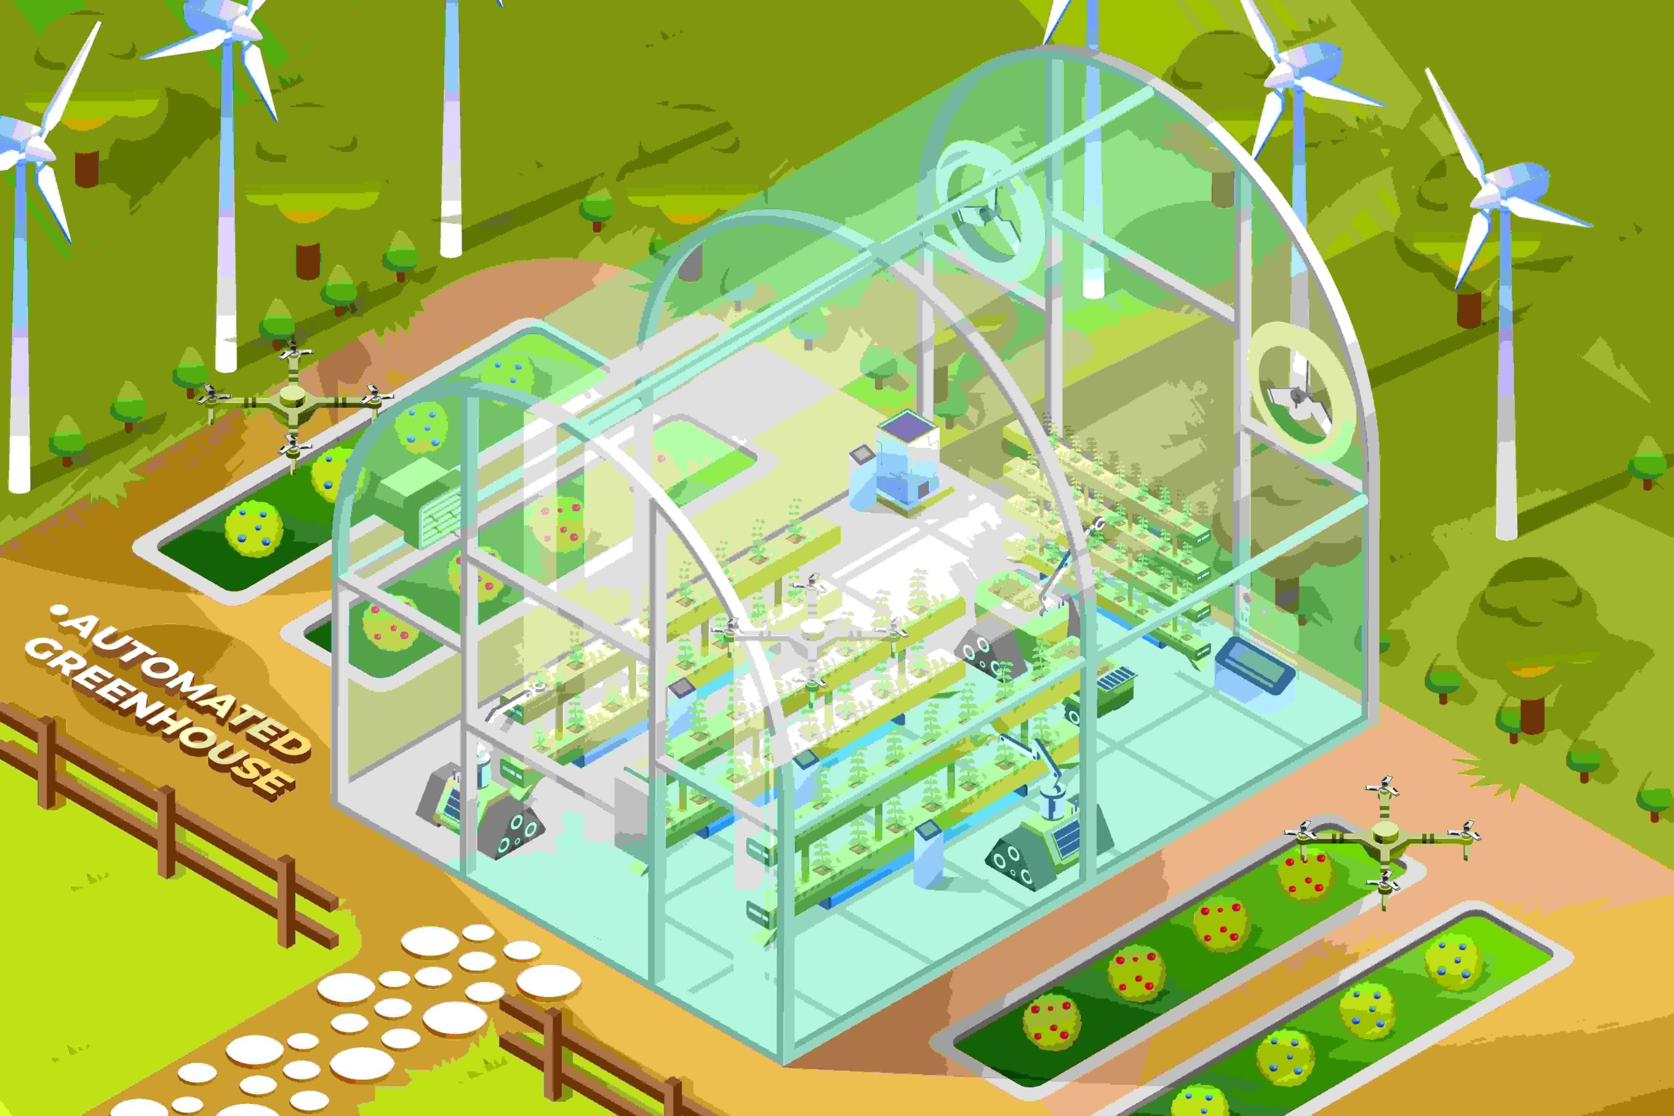
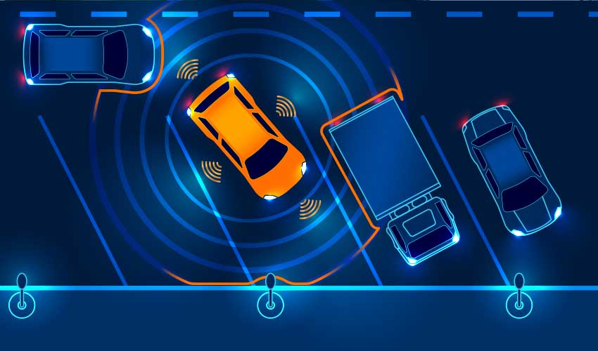
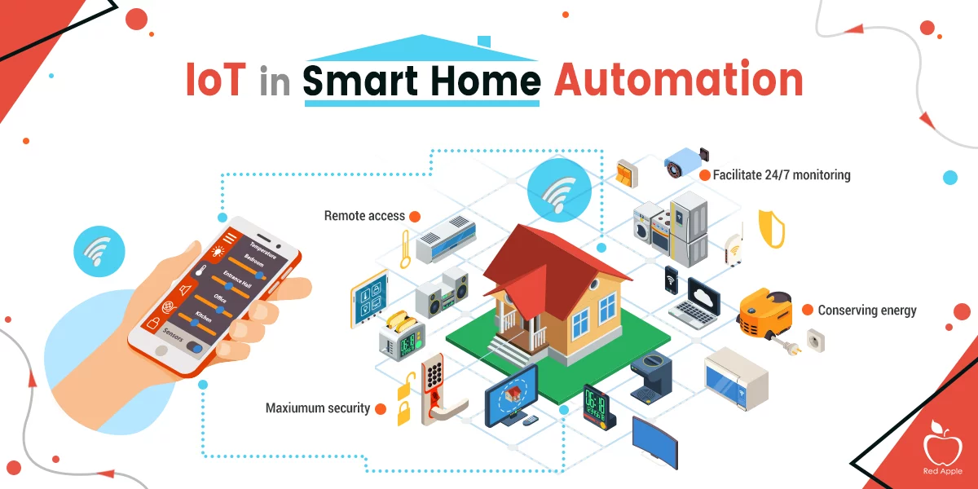

Smart Agriculture
Smart Vehicles
Smart Home
Smart Cities
AY 2023-2024
6

Slide 7
RESEARCH MOTIVATION
According to the MHRD report present traffic scenario in India is very concerning. With the increasing population India exhibits huge traffic congestion problem. The main reason to this problem is that country is emerging and developing at very rapid speeds.
The present system is not adaptive to the traffic conditions and number of vehicles in a particular lanes which makes the traffic conditions more hectic and congested at times.
Over speeding is one of the common reasons behind crashes. Humans tend to over speed and often lose control, leading to fatal accident.
We observe many accident are happening on the road due to many reasons like vehicles stoppage on the road side, no street lights on roads, lack of sleep etc.
The existing street lights system consumes more energy due to sodium vapor lamp and more man power is required and periodic check is necessary.

Slide 8
PROBLEM STATEMENT

Slide 9
Rescheduling algorithm of traffic light depend on the congestion of the other lane.
To enhance the street light for power consumption.
To enhance road safety by using different lights combination.
Upload all the data to the cloud for future analysis.

Slide 10
RESEARCH OBJECTIVE
The trafﬁc light control problem lies in how to adaptively react to dynamic trafﬁc change in order to improve efﬁciency control while ensuring equity for all lanes.
- The main contribution of the proposed algorithm is that it can effectively select the best possible setting for the green light sequence.

Slide 11
LITERATURE SURVEY

Slide 12
PAPER 1
IoT based Traffic Light Control System, 2018 International Conference on Control, Power, Communication and Computing Technologies (ICCPCCT)
INTRODUCTION:
Internet of Things (IOT) is an important research area which allows a strong connection to communicate between the physical objects through internet connectivity. The Internet of things is the interconnection between the physical objects such as cars, buildings, other vehicles, kitchen appliances and other embedded devices with electronics, software, sensors and actuators that enables these objects to send and receive data over a network without the requirement of human-to-human or human-to-computer interaction.

Slide 13
METHODOLOGY:
In the proposed system following are the design objectives
Distinguish the presence and absence of vehicles in road images.
Signal the traffic light to go red if the road is empty.
Signal the traffic light to go red if the maximum time for the green light has elapsed even if there are still vehicles Present on the road.
TECH USED:
The survey focuses on the utilization of IoT . The proposed system is implemented using raspberry pi and Arduino. MATLAB Simulink support package leads to easy implementation of the system. Density measurement is performed by raspberry pi.
AY 2023-2024
13

Slide 14
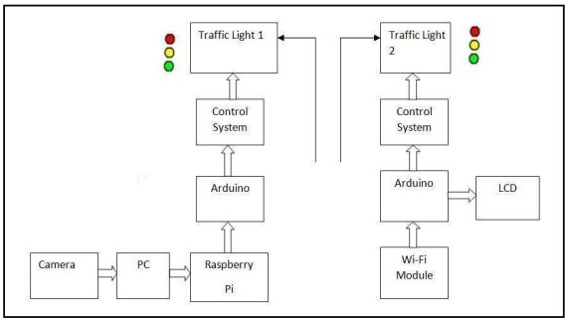
BLOCK DIAGRAM OF PROPOSED WORK:
CONCLUSION:
This paper discusses the IOT based traffic control system in which signal timings are updated based on the vehicle density on the road. The proposed system is implemented using raspberry pi and Arduino. MATLAB Simulink support package leads to easy implementation of the system. Density measurement is performed by raspberry pi. Proposed system gives good performance and helps to reduce traffic congestion. Results shows vehicle counting in real time. The proposed system is suitable for real time vehicle management.
AY 2023-2024
14

Slide 15
PAPER 2
Intelligent Energy Efficient Street Light Controlling System based on IoT for Smart City, 2018 International Conference on Smart Systems and Inventive Technology (ICSSIT)
INTRODUCTION:
Street lights are one of the consumable sources of electricity that are essential parts of the day to day life. The conventional street lighting systems require manual operation and also consume a large amount of power as they are in powered on condition from evening to early morning. The conventional manual operated street lighting systems consume a large amount of power, need manual operators and heavy cost on installation which has been a great disadvantage and an area of major concern.
AY 2023-2024
15

Slide 16
METHODOLOGY:
The proposed approach uses an energy effective approach that controls the street lights by automatically switching them when there are people or vehicles around the post when it is dark. The smart street lighting system is so flexible and it consists of various sensors and a controller which make it as an intelligent street lighting system. Thus it overcomes the disadvantages of the conventional Street Lighting System.
TECH USED:
The Intelligent energy efficient system uses IoT and LDR, LED devices, controller and communication devices and sensor.
AY 2023-2024
16

Slide 17
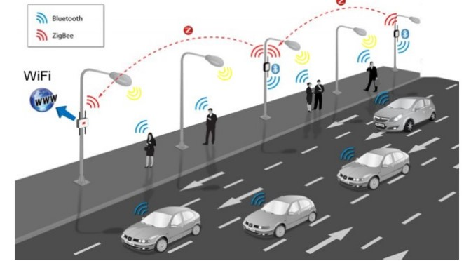
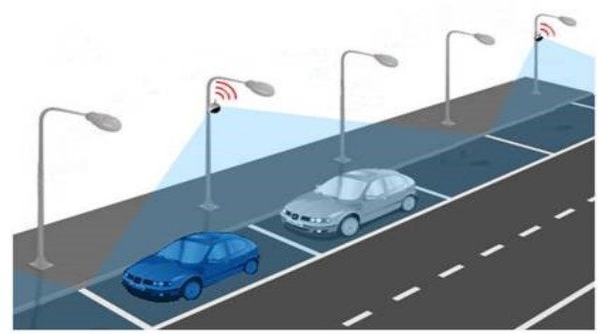
PROPOSED WORK:
CONCLUSIONS:
The proposed method concludes that the Smart Intelligent Street Lighting system helps in providing minimal power consumption in towns, municipalities and cities. It can be monitored through Thing speak cloud. Maintenance cost is also minimal and the reduced power consumption in today’s era makes it an immediate call at this hour. Since saving of energy plays an important role, this proposed method provides a good solution for reduced power consumption.
AY 2023-2024
17

Slide 18
PAPER 3
IOT based Smart Street Lighting System for Smart City, 2018 Chinese Automation Congress (CAC)
INTRODUCTION:
The online network based on possession’s implement us along a part of advanced automation that command go around sudden ongoing town in the direction of through to long haired capital. The SSLS continue the system that go around the street lights ON/OFF beyond one’s control. The present system option introduce a street light monitor Arduino uno panel whatever intention management the integrated system.
AY 2023-2024
18

Slide 19
METHODOLOGY:
In this system we can access the Arduino nano board by blink it light by uploading a source into it, it is the main part of the entire system because in this process we have done a lot about source code without it , entire system is useless.
TECH USED:
Arduino Uno, Sensors (LDR, IR).
CONCLUSION:
From the present project our own selves achieve a certain here is a entity and that essential utilization as long as to our Nation, chiefly due to the street lights act no more exploit accordingly aside the authority. In this project we have added some advanced technology we can operate the entire system with mobile or laptop, beyond this it also display the lifespan of the lamps. This project also has a more development we have a chance to trustworthy in the future scope.
AY 2023-2024
19

Slide 20
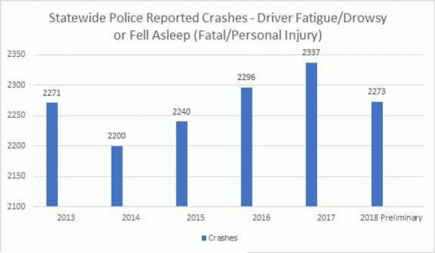
Figure shows the state wise crash report/ accident report.

Slide 21
DESIGN AND IMPLEMENTATION

Slide 22
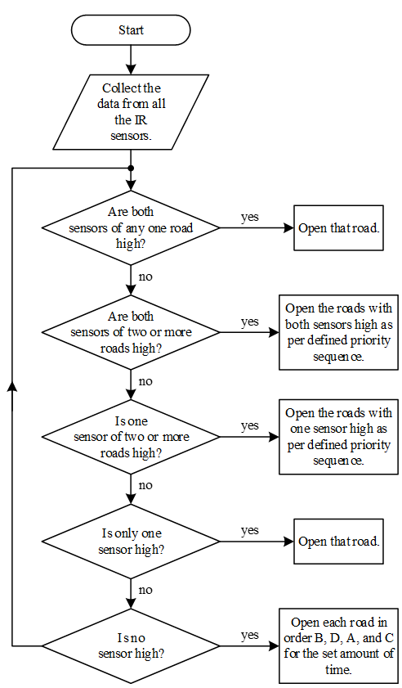
FLOW CHART
Objective 1: Rescheduling algorithm of traffic light depend on the congestion of the other lane.
Algorithm: Proposed Adaptive Algorithm
Input:
Q(t) : Total number of vehicles waiting at the traffic signal at Jth active lane in a Ith cycle;
T: Traffic cycle duration;
Output:
Green light sequence.
Begin
{
/* the function of checking the presence of vehicles returns true if at minimum one vehicle is present and the priority is given to the kth lane*/
1. If (VehiclePresent is false)Apply normal algorithm to the traffic light;
2. Else {
3. Calculate density for each lane.
4. If (density of any lane is more)Apply adaptive algorithm;
5. Assign the next green light to the phase with maximum density;
}
End.

Slide 23
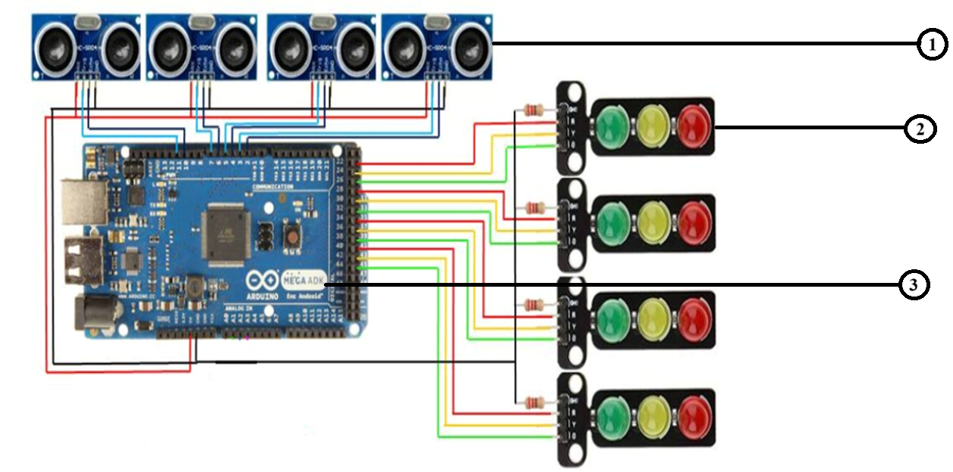
IMPLEMENTATION
Objective 1: Rescheduling algorithm of traffic light depend on the congestion of the other lane.
1. Ultrasonic Sensor.
2. Traffic Light.
3. Arduino Mega.

Slide 24
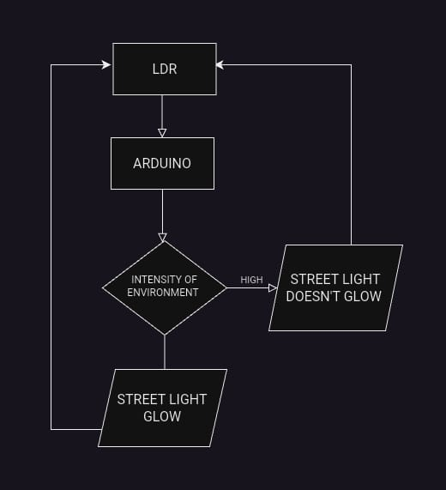
FLOW CHART
Objective 2: To enhance the street light for power consumption.

Slide 25
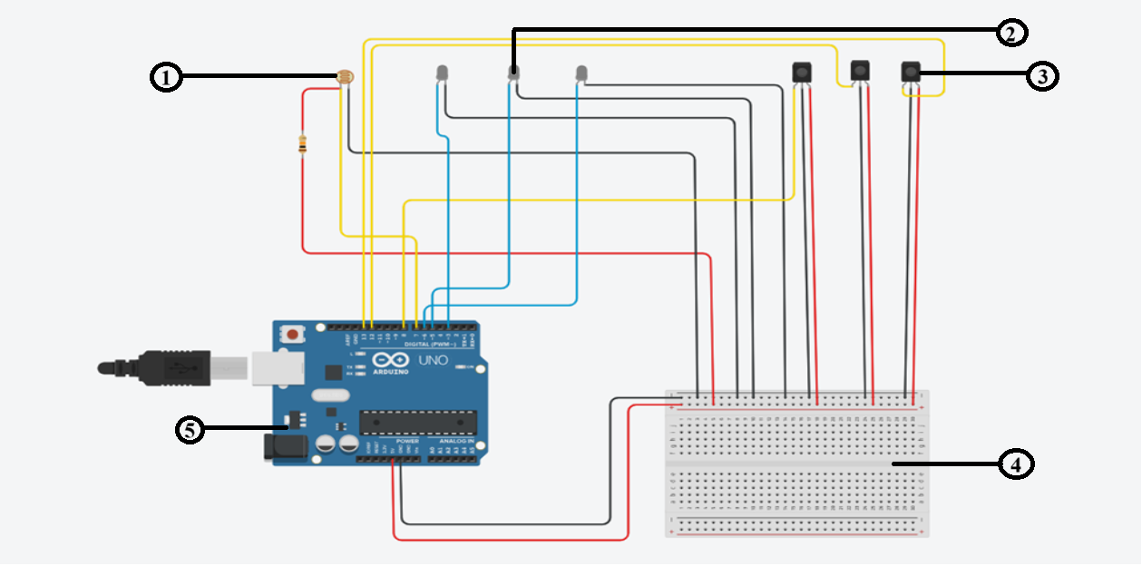
IMPLEMENTATION
Objective 2: To enhance the street light for power consumption.
LDR Sensor.
LED.
IR Sensor.
Bread Board.
Arduino Uno

Slide 26
RESULTS

Slide 27
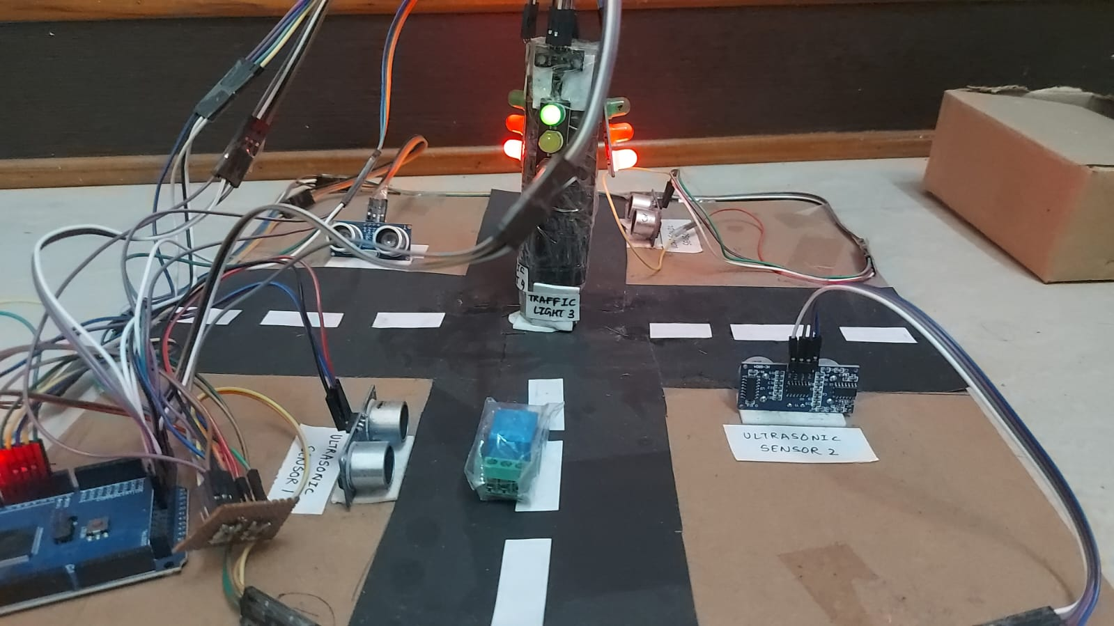
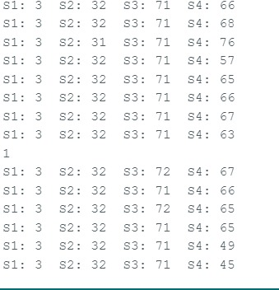
When the congestion is at signal 1, the reading get from the sensor is recorded and send to the Arduino and the time of the traffic light is rescheduled at signal 1.

Slide 28
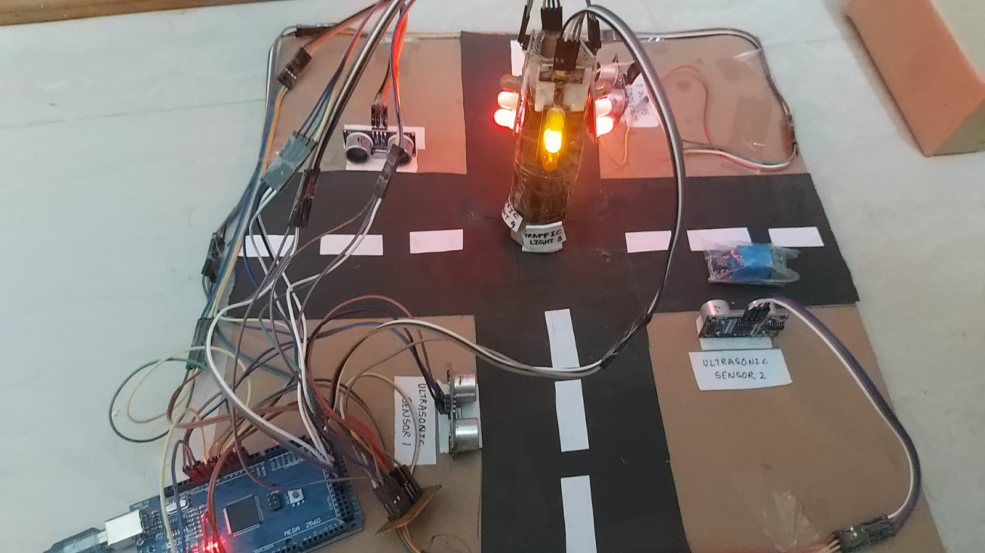
When the congestion is at other signal, the reading from the sensor is recorded and send to the Arduino and the rescheduling algorithm is done.

Slide 29
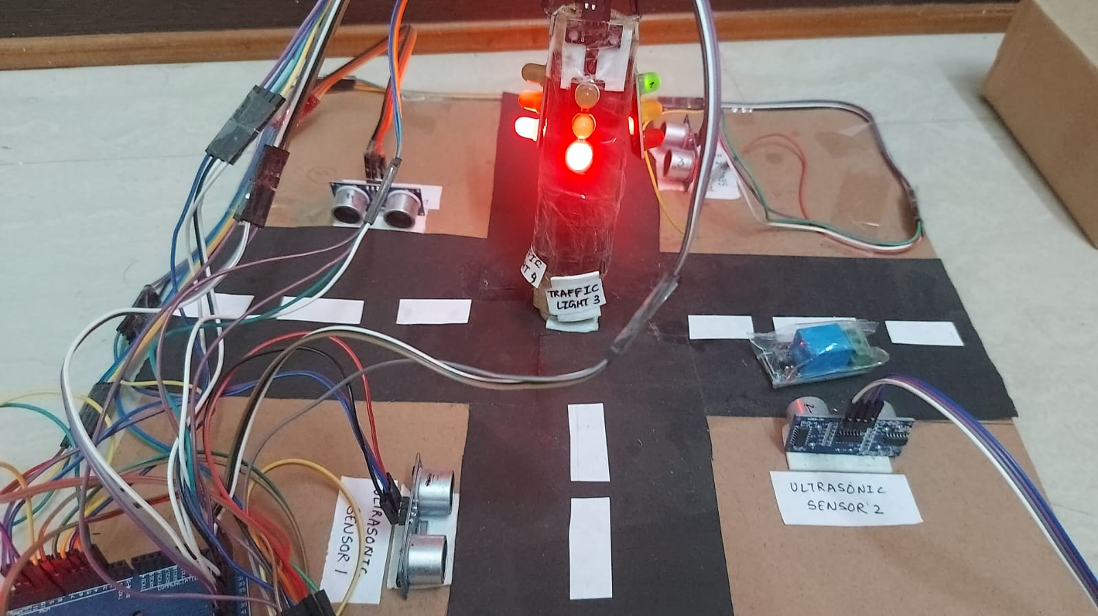
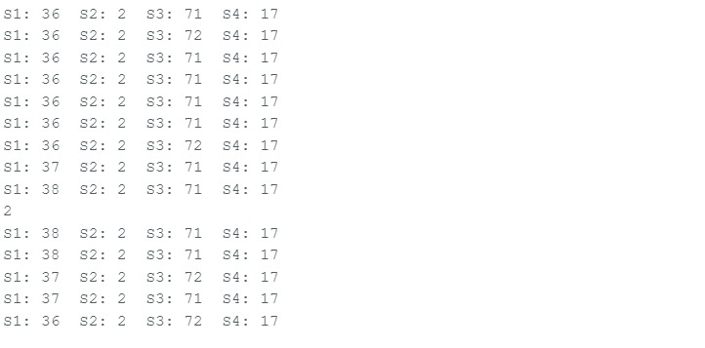
When the congestion is at other signal, the reading from the sensor is recorded and send to the Arduino and the rescheduling algorithm is done which changes the traffic light frequently so that time is save and no congestion occurs.

Slide 30
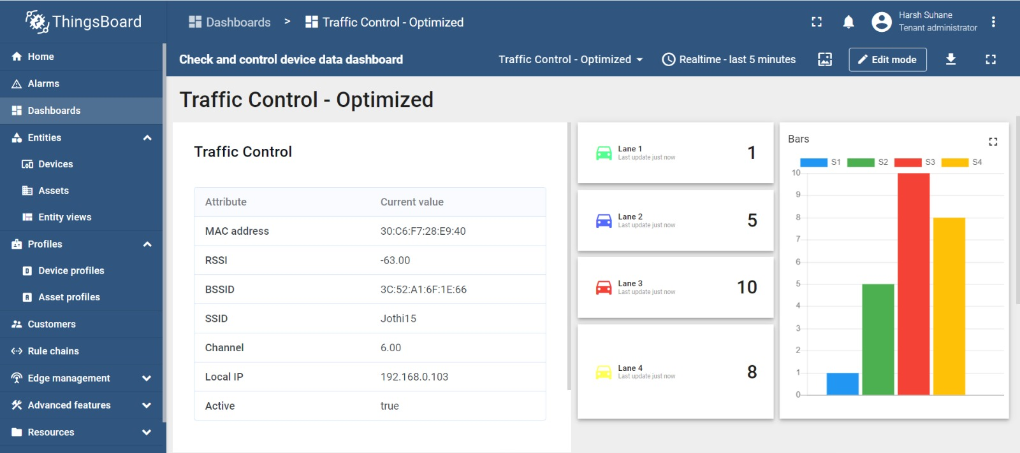
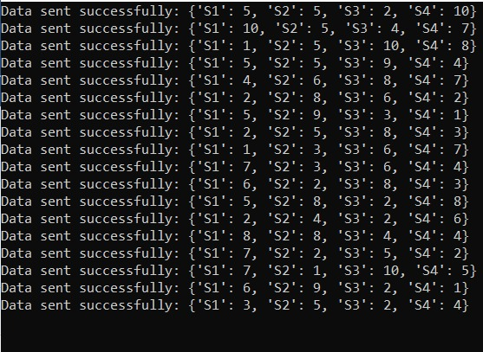
Cloud Implementation:
The data coming from the ultrasonic sensors are send to the cloud (ThingsBoard), which can be use for future analysis.

Slide 31
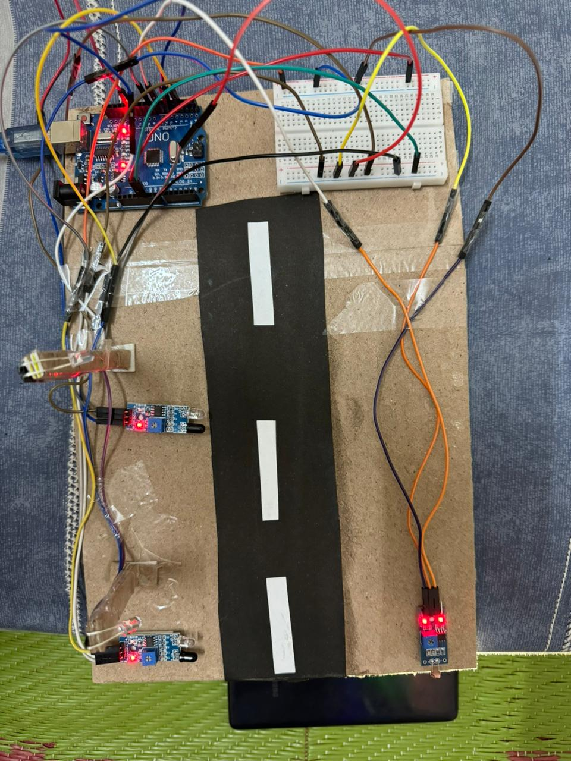
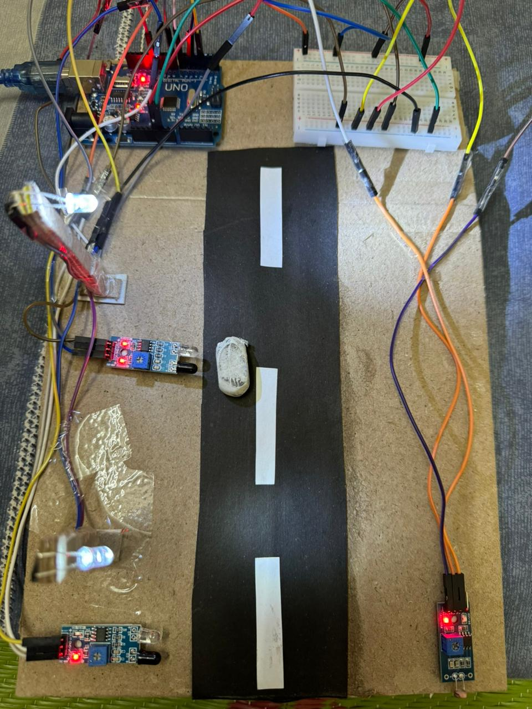
(a) (b)
Represents the energy conservation of street light, which has two case, in first case that is:-
(a) in which the street lights are off when the intensity of surrounding is high.
(b) the street light turn on when intensity of surrounding is low and the intensity of light increases when an vehicle come Infront of the sensor.

Slide 32
CONCLUSIONS
The present study focuses on all the various researches made in road safety with the help of IoT. It is seen that, with the help of IoT, the safety system can be updated on a real-time basis which can help to create a smart, intelligent, and highly efficient road safety system.
The true power of IoT in ensuring safe driving continues to be unleashed as cars move towards becoming fully autonomous and start interacting with their environment and making decisions on their own. This will prevent drivers from entering hazardous areas, assisting in avoiding collisions, selecting detours, and avoiding traffic congestions.

Slide 33
REFERENCES
1. Papageorgiou, M., Kiakaki, C., Dinopoulou, V., Kotsialos, A., Wang, Y.: Review of road trafﬁc control strategies. Proc. IEEE 91, 2043–2067 (2003)
2. Jabbarpour, M.R., et al.: Ant-based vehicle congestion avoidance system using vehicular networks. Eng. Appl. Artif. Intell. 36, 303–319 (2014)
3. Pan, J., Khan, M.A., Popa, I.S., Zeitouni, K., Borcea, C.: Proactive vehicle re-routing strategies for congestion avoidance. In: 2012 IEEE 8th International Conference on Distributed Computing in Sensor Systems, pp. 265–272 (2012)
4. Pan, J., Popa, I.S., Borcea, C.: DIVERT: a distributed vehicular trafﬁc re-routing system for congestion avoidance. IEEE Trans. Mob. Comput. 16, 58–72 (2017)
5. Jovanovi´c, A., Nikoli´c, M., Teodorovi´c, D.: Area-wide urban trafﬁc control: a bee colony optimization approach. Transp. Res. Part C Emerg. Technol. 77, 329–350 (2017)
6. Li, X., Sun, J.-Q.: Signal multiobjective optimization for urban trafﬁc network. IEEE Trans. Intell. Trans. Syst. 19, 3529–3537 (2018)
7. McKenney, D., White, T.: Distributed and adaptive trafﬁc signal control within a realistic trafﬁc simulation. Eng. Appl. Artif. Intell. 26, 574–583 (2013)

Slide 34
THANK YOU!!

